Slide 1
TSSM’s Padmabhooshan Vasantdada Patil Institute of Technology, Bavdhan Department of Mechanical Engineering
“Design And Manufacturing Of Automatic Overhead Conveyor Gripper System For Chemical Material Process”
By
Mr. Shubham Shinde Mr. Piyush Mahajan
Mr. Rushikesh Shinde Mr. Raghuraj Yadav
Guided By
Prof. A.N. Sande

Slide 2
CONTENTS
1. Introduction 09. Advantages
2. Problem Statement 10. Disadvantages
3. Solution 11. Applications
4. Abstract 12. Conclusion
5. Objectives
6. Methodology
7. Experimental Setup
8. Arduino Board

Slide 3
INTRODUCTION
In industries the material handling is done manually but workers safety concerns it is danger to handle chemicals manually.
So in the industries the automation plays very important role. In our project we are using the rack & pinion mechanism to move the material from one place to another in x direction. & to lift the material we are using the lead screw mechanism.
Various Types of X-Y control Positioning System is used in industries for many purpose. In industry this mechanism is operated by PLC and Microcontroller.

Slide 4
PROBLEM STATEMENT
In powder coating process the handling of product is now very difficult as it done manually.
If the size of the component is larger than the regular size it is difficult for lifting and handling those components.
As it is required to find the alternative to handling of products.

Slide 5
SOLUTION
So we are designing a system that can lift the material which is automated system.
Design and develop the ‘Design and Manufacturing of X-Y Gantry mechanism for material handling'.
which will do pick and place operation for material handling concern.

Slide 6
ABSTRACT
In powder coating industry there will be heavy and large amount of components for the process. For powder coating process the components need to be taken to three stages.
For taking this component to this stages it needs to be lifted. This lifting is time consuming and difficult.
We need labours for this and thus it can create accident.
Thus for this purpose we are creating a mechanism that would save our time. For horizontal and vertical movement we use lead screw. The feed is supplied to the lead screw with DC motor. And for holding the component we use grippers.

Slide 7
OBJECTIVES
The objective of material handling system are as follows:-
To design & developed the X- y mechanism for the
application.
To manufacture the system.
To perform pick and place operation.
To reduce labour work & increase human safety.
To save material handling time and cost.
To improve work efficiency.

Slide 8
Methodology
First we will design the X-Y Gantry system suitable to our application. In which we will design lead screw for X-Y movement and gripper for holding the product. We can use the following methods for achieving the X-Y motion.
Analytical: Then we will analyze the design in ANSYS for static and dynamic conditions for different load lifting capacity.
Experimentally: in our project we will make an experimental setup for finding effective X-Y Gantry system.

Slide 9
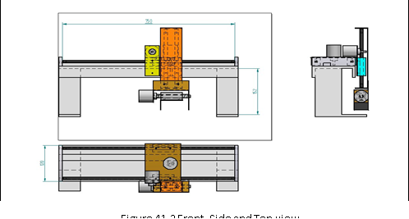
Experimental Setup

Slide 10
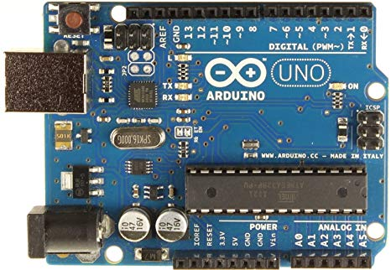
ARDUINO
Arduino is an open-source hardware and software company, project and user community that designs and manufactures single-board microcontrollers and microcontroller kits for building digital devices. Its products are licensed under the GNU Lesser General Public License (LGPL) or the GNU General Public License (GPL), permitting the manufacture of Arduino boards and software distribution by anyone. Arduino boards are available commercially in preassembled form or as do-it-yourself (DIY) kits.

Slide 11
ADVANTAGES
For heavy material easy handling.
Mechanism is automated.
Less time is required.
Lifting as well as transferring of material is possible.
Interference with the work on the floor is minimized .
Valuable floor space is saved for truck rather than being utilized for installation of handling equipment.
Such equipment is capable of handling heavy loads.
Such equipment can be used for loading & unloading of materials.

Slide 12
DISADVANTAGES
Maintenance is required.
Initial cost is high.
They require heavy investment (especially bridge cranes)
They serve a limited area
Some cranes move only in straight line & thus can not make turns
Utilization may not be as high as desirable since cranes are used only for a short time during daily work

Slide 13
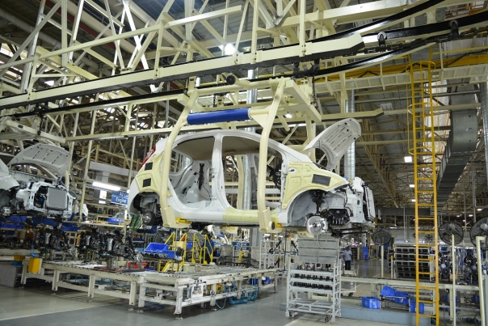
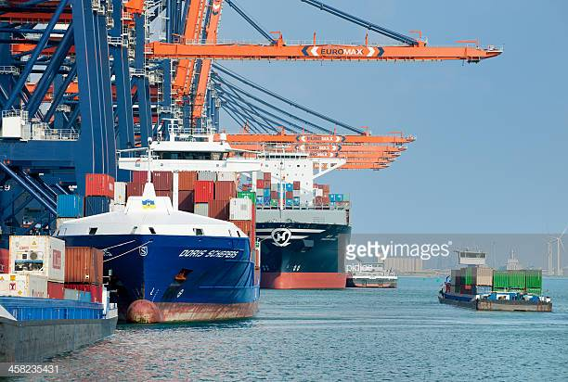
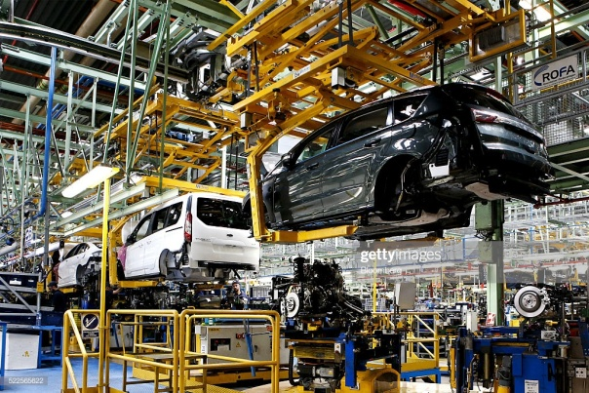
APPLICATION
Shipyards & heavy equipment production facilities
Chemical Industry – Material Handling Process
Aerospace- To Handle the turbines use for jet propulsion

Slide 14
Future Scope
A conveyor comes across as a usual piece of motorized management equipment that transport recourses from one location to another.
Conveyer are beneficial in application pertaining to the conveyance of bulky or huge recourses.
Conveyor systems ensure high grade of security.
By producing such system the scope in the field of manufacturing identification of suitable solution evaluation processes design the proposal to build the prototype also we can used such system with some modification
Future market potential of conveyor and transmission belts is linked to new project s likely to be setup or expansion of the existing projects

Slide 15
CONCLUSION
This Overhead Conveyor System for material handling is improves the speed of material handling. And this system reduces the human effort. The workers are eliminated and the ultimately the operation cost is reduced and profit get increased. This system is beneficial and safety for the material.

Slide 16
THANK YOU

